Slide 1


TRAVEL BOOKING SYSTEM
CSA 4317-INTRNET PROGRAMMING WITH MOBILE APP INTEGRATION
Project supervisor:
Ms. L. Reetha
Presented By
D. Teja (192210626)
K. Ganesh (192210041)

Slide 2


Introduction
Personalized Travel Plans
Comprehensive Options
Our system allows you to create custom itineraries, choosing your preferred destinations, dates, and budget.
Access a wide range of flights, hotels, car rentals, activities, and travel insurance options, all in one platform.
Seamless Booking Process
Enjoy a streamlined booking experience with secure payment methods and instant confirmations.

Slide 3
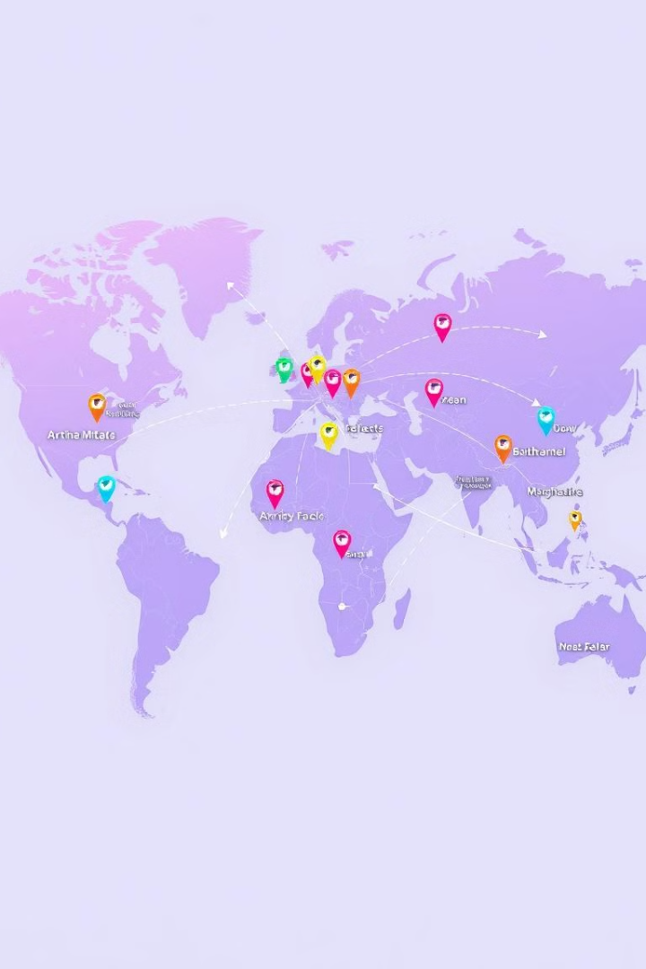
Aim and Objectives
1
User-Friendly Interface
2
Comprehensive Options
The system prioritizes a simple, intuitive interface for seamless user navigation and booking.
Offer a wide range of travel options, including flights, hotels, car rentals, and vacation packages.
3
Real-Time Availability
4
Secure Transactions
Display up-to-date information on flight schedules, hotel availability, and pricing.
Ensure safe and reliable payment processing with secure encryption protocols.

Slide 4
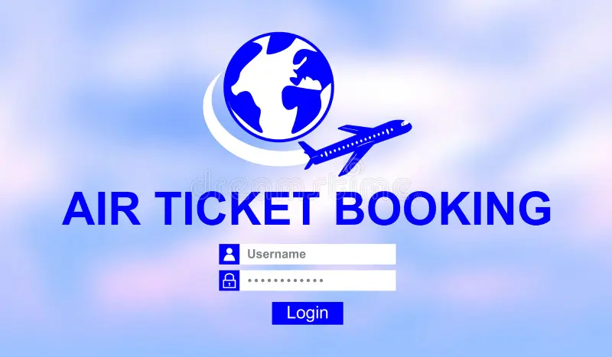
Existing System and Drawbacks
Traditional Agencies
Limited options, inflexible booking processes, high fees, and potential for human error.
Drawbacks
Out dated technology
Limited search options
Lack of mobile optimization
Performance Risks
Higher maintenance Needs

Slide 5
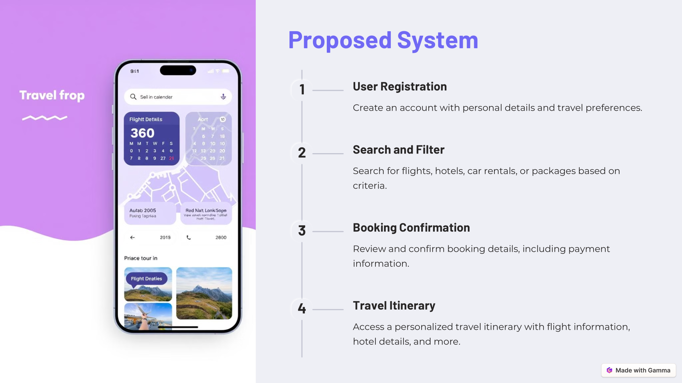

Slide 6
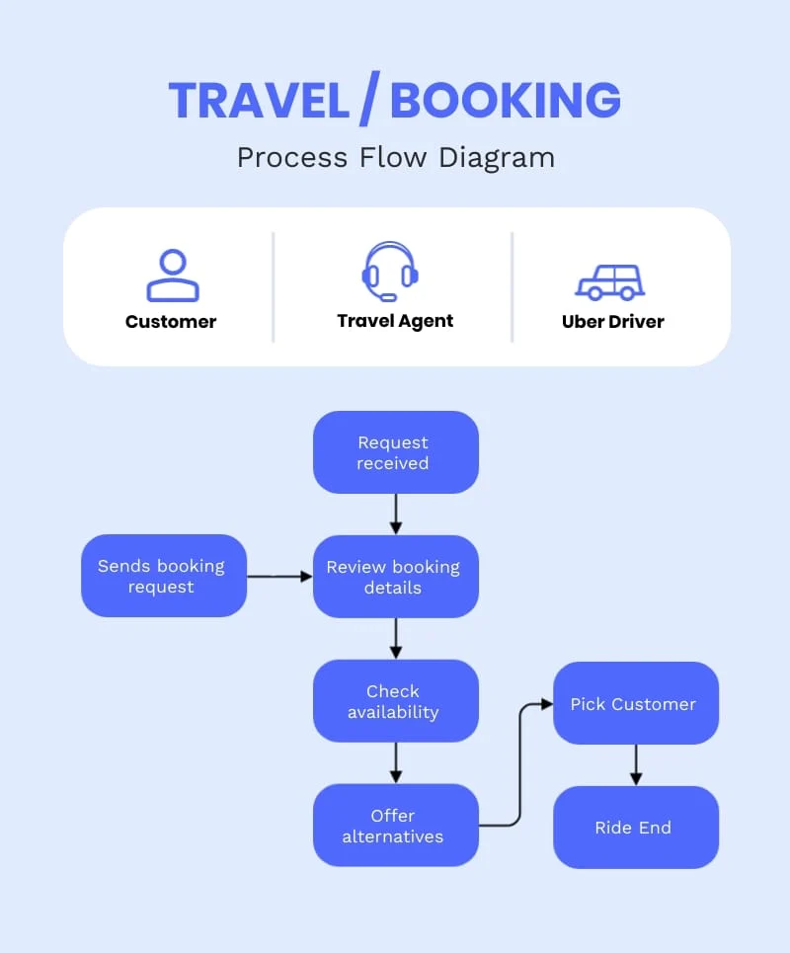
Block Diagram
User Interface
Provides a platform for users to interact with the system.
Search Engine
Processes user search queries and retrieves relevant travel options.
Database
Stores travel data, including flight schedules, hotel information, and customer details.
Payment Gateway
Facilitates secure online payment processing for bookings.
Travel APIs
Integrate with external travel providers to retrieve real-time information.

Slide 7



Techniques Used
The development of the system utilizes modern technologies and best practices to ensure its effectiveness and robustness.
Frontend development is how to create a website's user interface visually and in terms of interactivity. It means web development enabling Execute Web Design using coding languages such as HTML, CSS, and JavaScript.
The back end is a combination of servers and databases. Servers control how users access files. Databases are organized and structured collections of data.

Slide 8
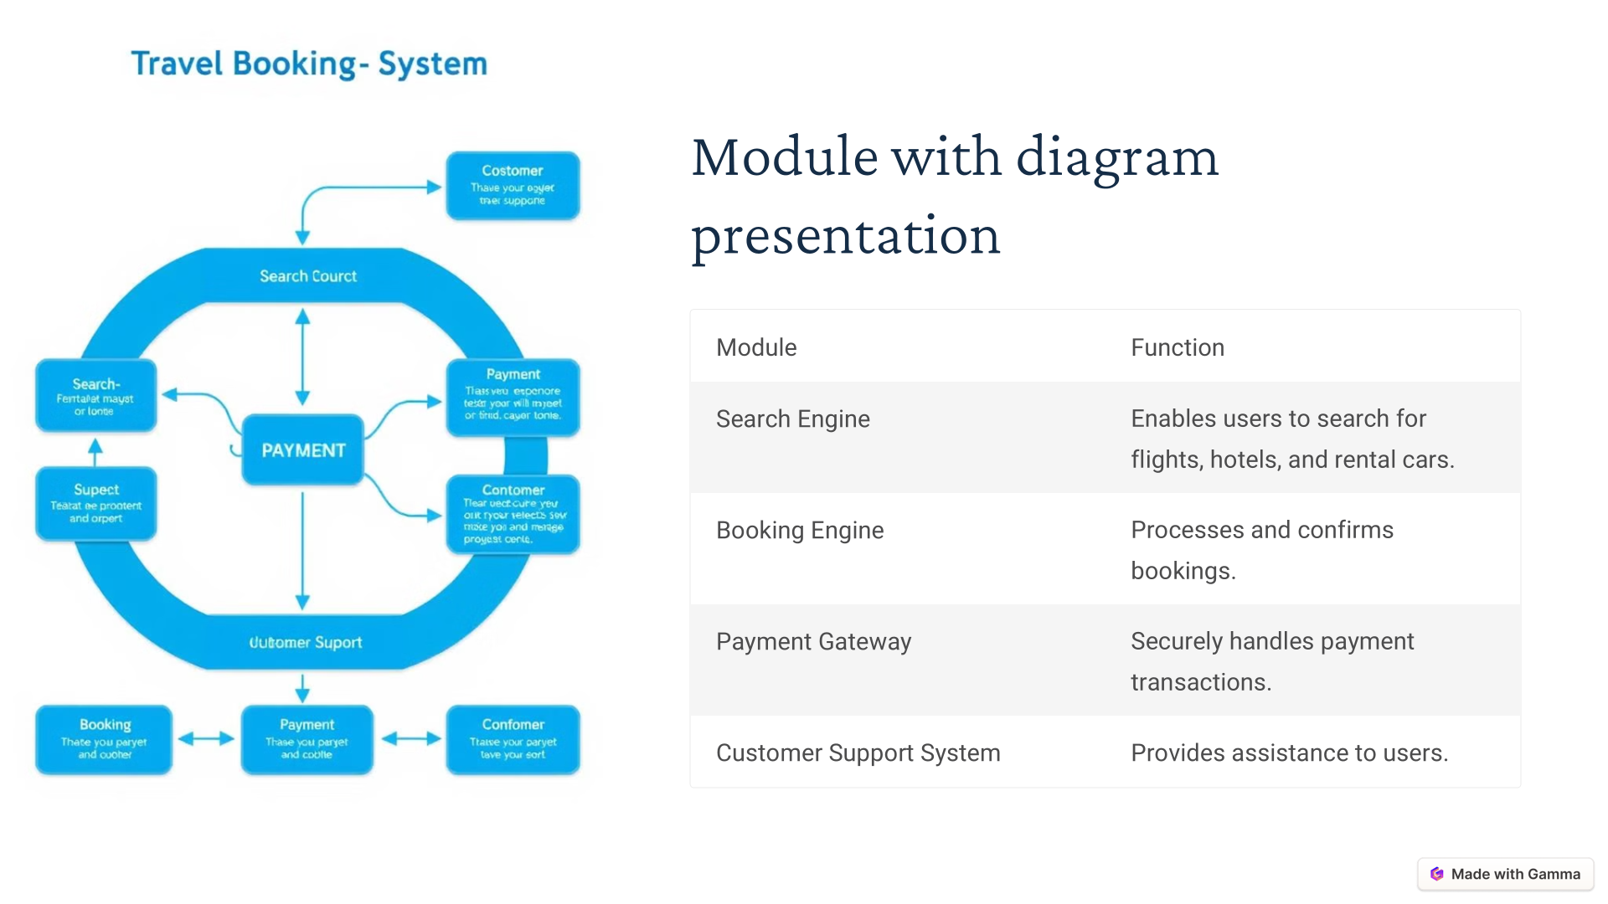


Slide 9
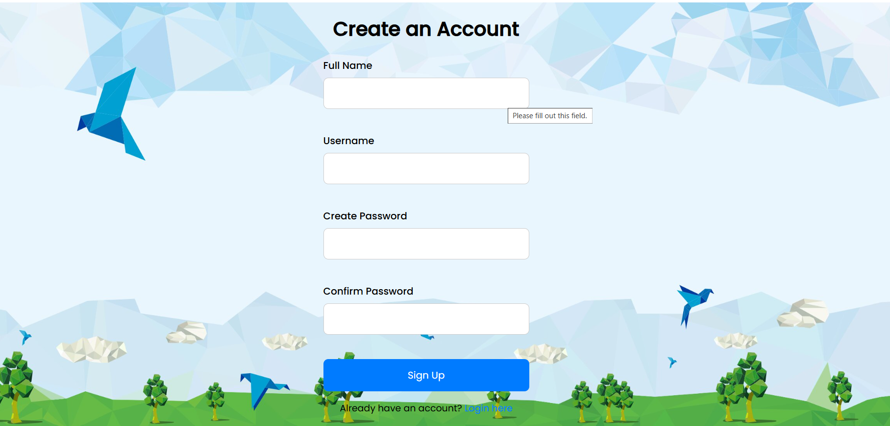

Slide 10
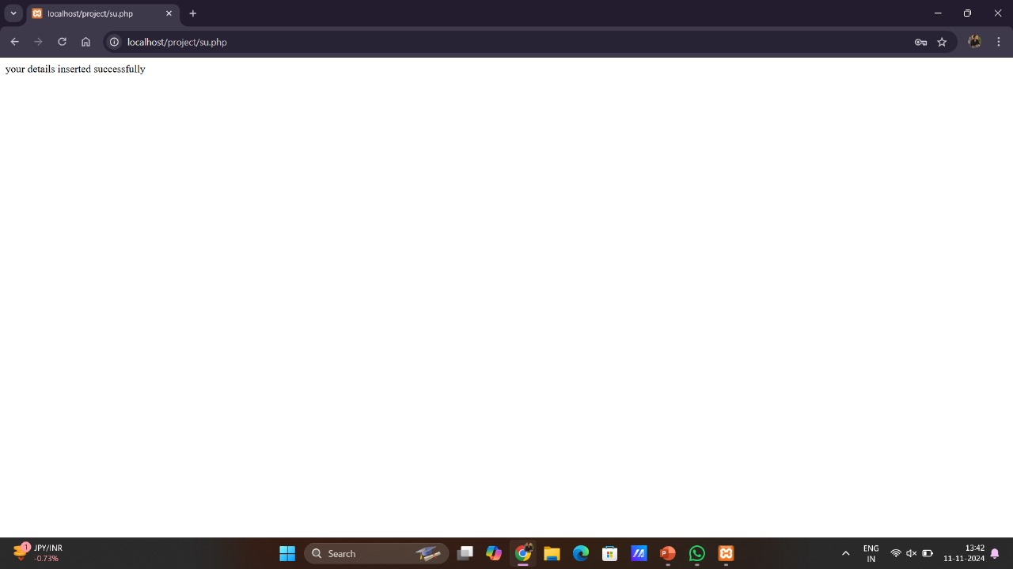

Slide 11
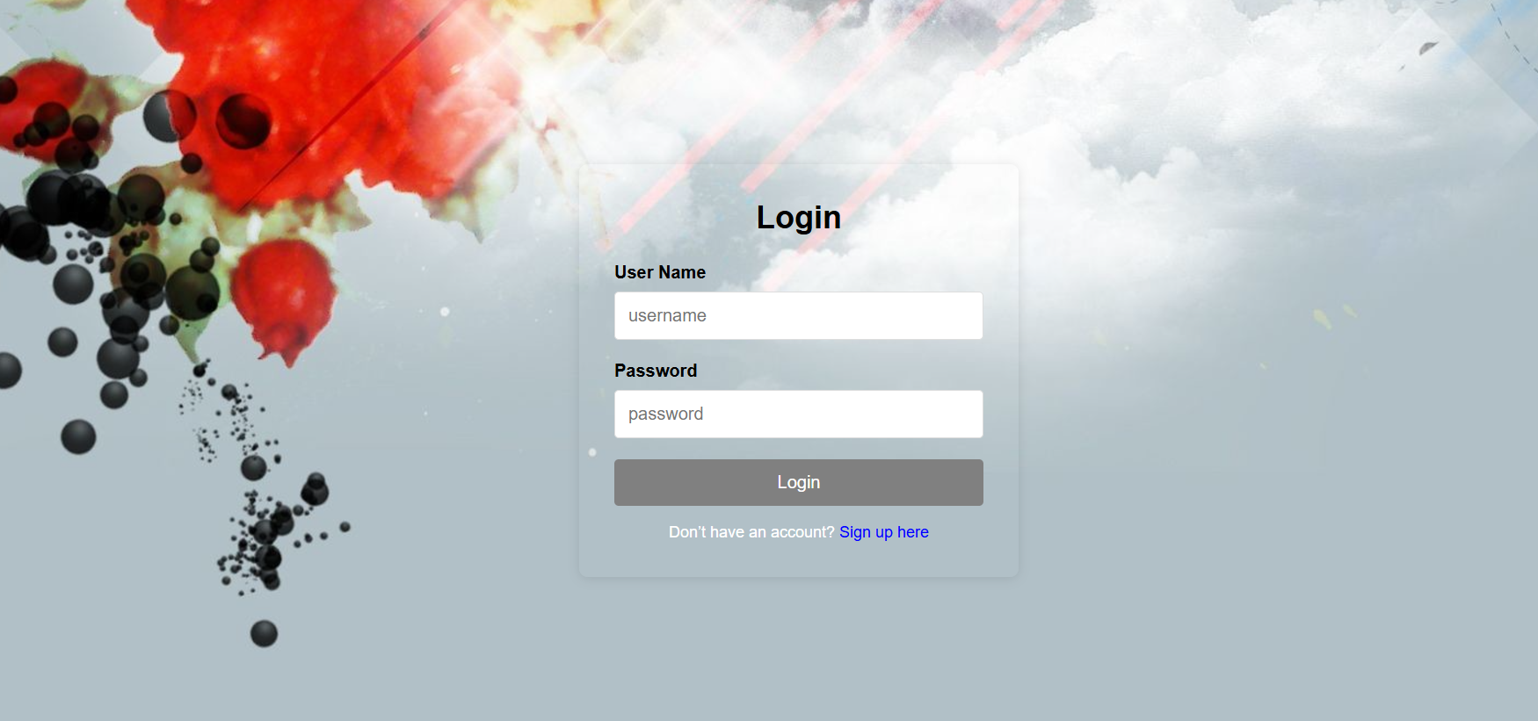

Slide 12
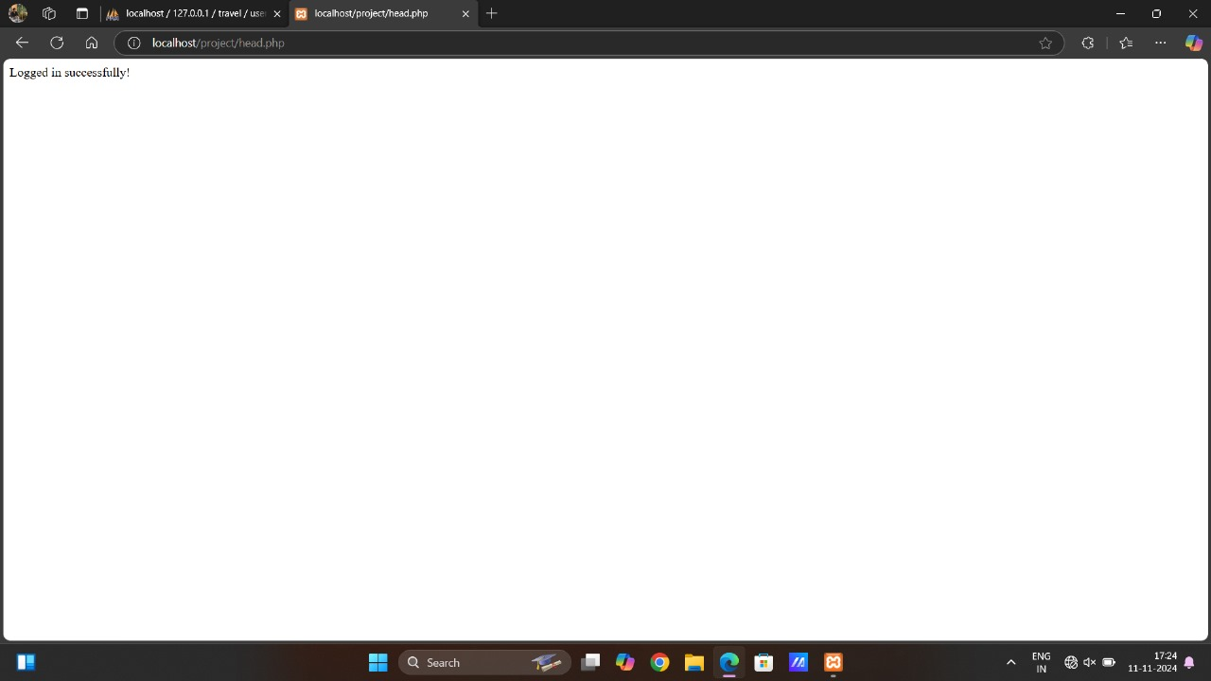

Slide 13
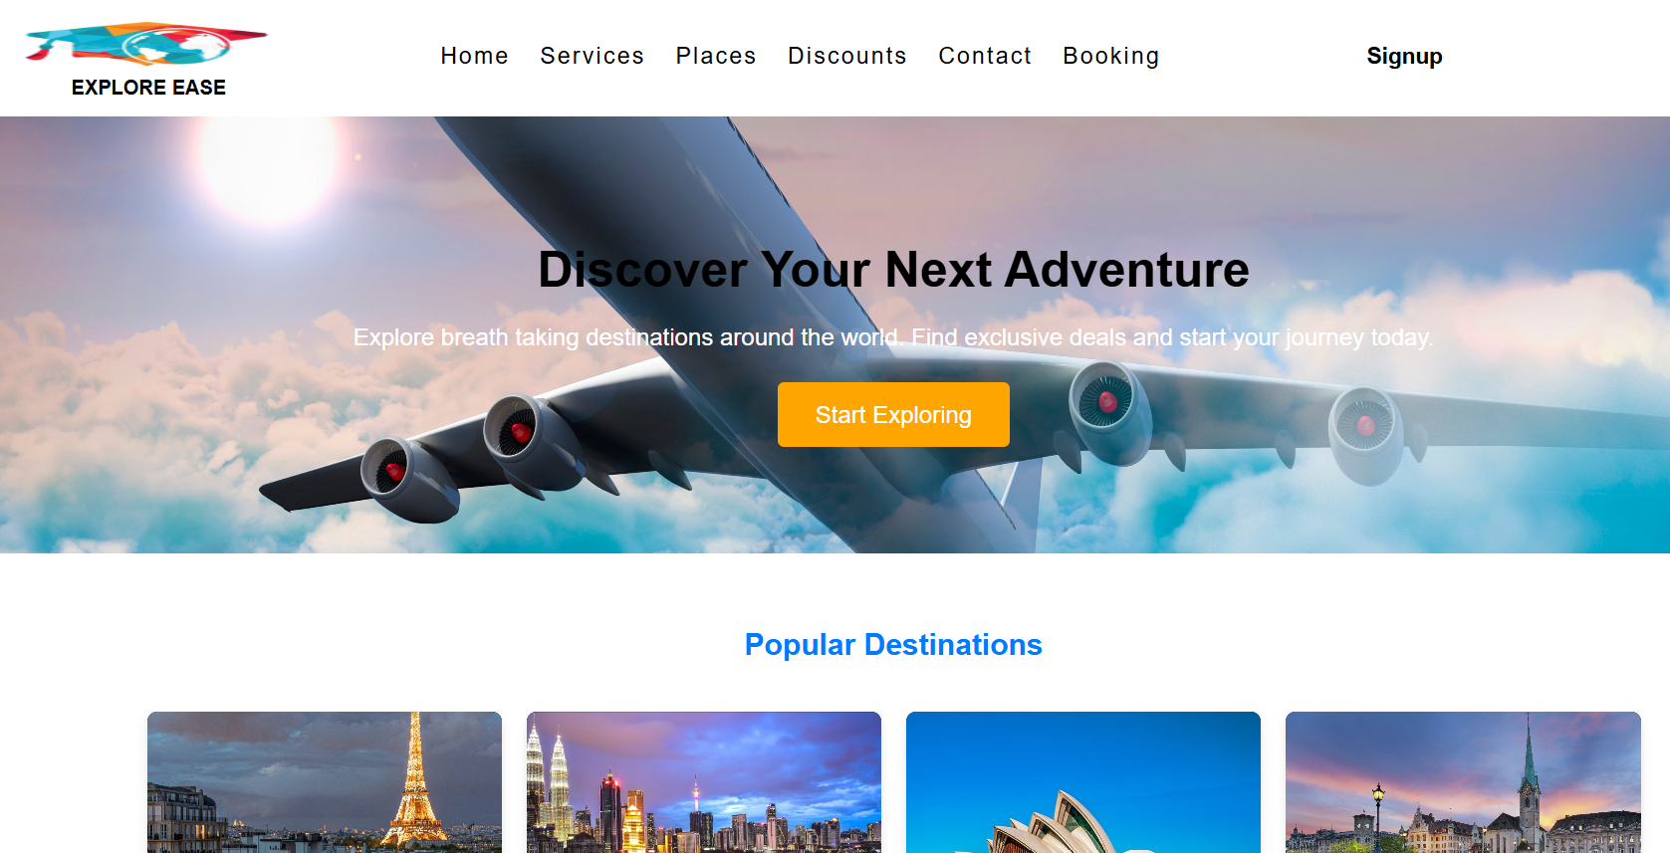

Slide 14


Slide 15




Conclusion and Future Enhancements
User Experience
Continuously improve the user experience by incorporating feedback and implementing new features.
Personalized Recommendations
Develop AI-powered recommendations based on user preferences and past travel history.
Virtual Reality Integration
Explore the potential of virtual reality to provide immersive previews of destinations and accommodations.

Slide 16


